Slide 1
Learning Rate Dropout
IEEE 2022
0716206 陳昱丞
310551175 蔡金玲

Slide 2
Motivation

Slide 3
Existing optimization algorithms:
slowly converging or not seeking to avoid bad local optima
Small networks are easier to converge than big networks:
freeze some parameters of big network,
update only the remaining parameters

Slide 4
Introduction

Slide 5
Regularization techniques
dropout
weight decay
noisy label
Unexpected perturbations gives the optimizer
more opportunities to escape from bad local optima
and find better results

Slide 6
Standard Dropout v.s. Learning Rate Dropout
Standard Dropout:
Randomly dropping the hidden units
Learning Rate Dropout (LRD):
Randomly dropping the learning rate of model parameters
Randomly determining which parameters are not updated
Only performs in the process of back propagation

Slide 7
each parameter
remained
updated
probability p
1 - p
Gradient of W1
learning rate
dropped
G1
G2
.
.
.
Gn
lr
0
.
.
.
lr
Temporarily set learning rate = 0
Store the momentum

Slide 8
Method

Slide 9









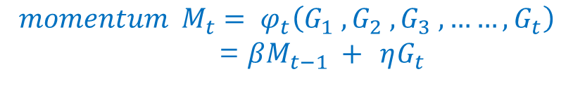
Stochastic Gradient Descent (SGD)
$${W=(w}^{(1)}, w^{(2)},……,w^{(n)})$$
parameters
$$gradient { G}_{t}= ∇f_{t}\left(W_{t−1}\right)$$
$$W_{1}$$
$$W_{2}$$
loss
$$W_{3}$$
$$momentum { M}_{t}= φ_{t}\left(G_{1} , G_{2} , G_{3} , ……, G_{t}\right)$$
= $βM_{t−1} +$ $ηG_{t}$
.
. .
.
.
.
In Pytorch SGD:
momentum
dampening
$$W_{t−1}$$
$$W_{t}$$
$$∆W_{t}= M_{t}$$
timestamp
$$W_{t} = W_{t−1} − ∝ ∙∆W_{t}$$
learning rate

Slide 10

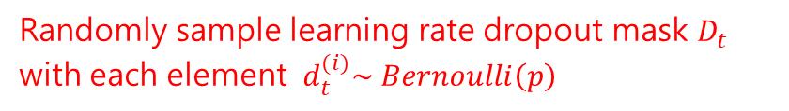
















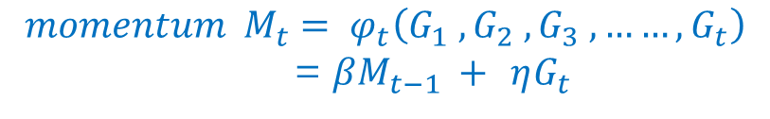

Learning Rate Dropout (LRD)
$$D_{t}$$
$${W=(w}^{(1)}, w^{(2)},……,w^{(n)})$$
$$∝$$
$$0$$
$$∝$$
$$1$$
parameters
$$A_{t}=$$
.
. .
.
.
.
.
. .
.
.
.
$$gradient { G}_{t}= ∇f_{t}\left(W_{t−1}\right)$$
$$W_{1}$$
$$∝$$
$$0$$
$$W_{2}$$
loss
$$W_{3}$$
$$momentum { M}_{t}= φ_{t}\left(G_{1} , G_{2} , G_{3} , ……, G_{t}\right)$$
= $βM_{t−1} +$ $ηG_{t}$
.
. .
.
.
.
Exponential Moving Average (EMA)
smaller
bigger
$$W_{t−1}$$
$$W_{t}$$
$$∆W_{t}= M_{t}$$
timestamp
Randomly sample learning rate dropout mask $D_{t}$
with each element $d_{t}^{(i)}\sim Bernoulli\left(p\right)$
$$A_{t} = ∝ ∙D_{t}$$
learning rate
dropout rate
$$W_{t} = W_{t−1} − A_{t}∙∆W_{t}$$

Slide 11
Mathematical Derivation

Slide 12

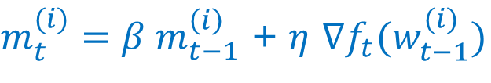
Stochastic Gradient Descent (SGD)
$m_{t}^{(i)}=β m_{t−1}^{\left(i\right)}$ + $η$ $∇f_{t}(w_{t−1}^{(i)})$
$$w_{t}^{(i)}= w_{t−1}^{(i)} − ∝{ ∙m}_{t}^{\left(i\right)}$$

Slide 13
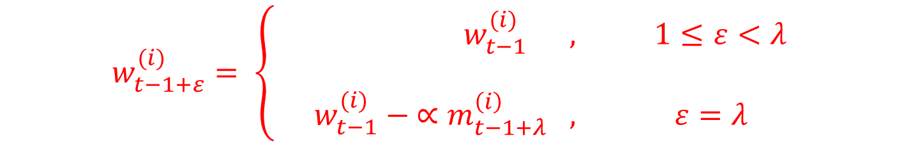
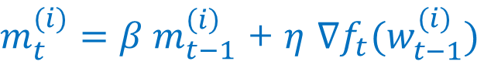
Learning Rate Dropout (LRD)
$m_{t}^{(i)}=β m_{t−1}^{\left(i\right)}$ + $η$ $∇f_{t}(w_{t−1}^{(i)})$
保持不變 (drop)
update freq
$$w_{t−1+ε}^{(i)}= \left\{\begin{aligned} w_{t−1}^{(i)} , 1≤ε<λ \\ \\ w_{t−1}^{(i)} − ∝m_{t−1+λ}^{\left(i\right)} , ε=λ\end{aligned}\right.$$
(週期性的) timestamp
update

Slide 14
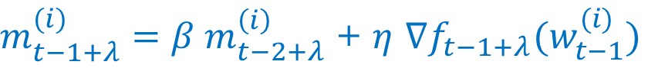



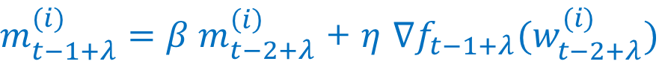

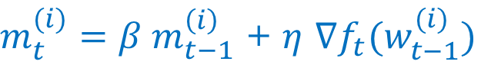
$m_{t}^{(i)}=β m_{t−1}^{\left(i\right)}$ + $η$ $∇f_{t}(w_{t−1}^{(i)})$
$$w_{t−1+ε}^{(i)}= \left\{\begin{aligned} w_{t−1}^{(i)} , 1≤ε<λ \\ \\ w_{t−1}^{(i)} − ∝m_{t−1+λ}^{\left(i\right)} , ε=λ\end{aligned}\right.$$
$m_{t}^{(i)}=β m_{t−1}^{\left(i\right)}$ + $η$ $∇f_{t}(w_{t−1}^{(i)})$
$$t t−1+λ$$
從 t 開始，過了 $λ$ 時間才 update
$m_{t−1+λ}^{(i)}=β m_{t−2+λ}^{\left(i\right)}$ + $η$ $∇f_{t−1+λ}(w_{t−2+λ}^{(i)})$
保持不變 (drop)
$m_{t−1+λ}^{(i)}=β m_{t−2+λ}^{\left(i\right)}$ + $η$ $∇f_{t−1+λ}(w_{t−1}^{(i)})$
$m_{t−1+λ}^{(i)}=β^{λ} m_{t−1}^{\left(i\right)}$ + $η$ $\left[ \sum_{ε=1}^{λ}{ β^{λ−ε} ∇f_{t−1+ε}(w_{t−1}^{(i)})} \right]$

Slide 15
$m_{t−1+λ}^{(i)}=β^{λ} m_{t−1}^{\left(i\right)}$ + $η$ $\left[ \sum_{ε=1}^{λ}{ β^{λ−ε} ∇f_{t−1+ε}(w_{t−1}^{(i)})} \right]$
影響較小
Accumulating multiple gradients at the same parameter position
give the optimizer more energy to escape from the local optimum

Slide 16
example

Slide 17


$$f\left(x, y\right)={(1.5−x^{2}+xy)}^{2} + {(2.25−x^{2}+xy^{2})}^{2} + {(2.625−x^{2}+xy^{3})}^{2}$$
where $x∈\left[−4, 0\right] ,$
$$y∈\left[−2, 3\right]$$
Optimal solution = ( -0.74 , 1.40 )

Slide 18
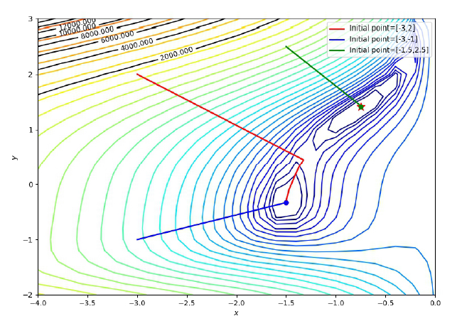
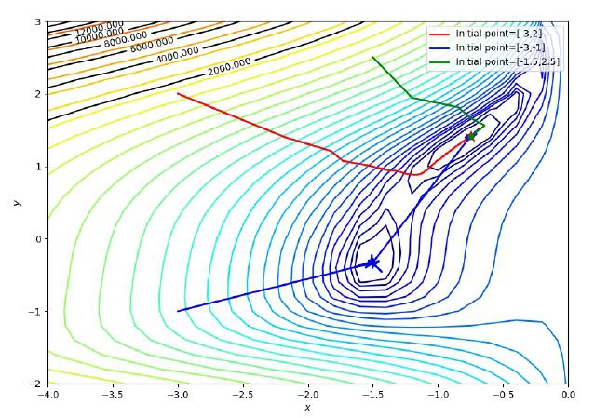

Adam
Adam with LRD

Slide 19
Advantages
Smaller network to update
Easier to converge
Momentum to escape
More active and exploratory

Slide 20
experiments

Slide 21
Image Classification
Fully Connected, ResNet-34, DenseNet-121, ResNeXt50, ResNet-50
MNIST, CIFAR-10, CIFAR-100, Tiny-ImageNet, ImageNet
Image Segmentation
PSPNet
VOC2012
Object Detection
SSD
VOC2012, VOC2007
Compare With Other Regularizations
No regularization, Standard dropout, Noise label, Gradient centralization, LRD, LRD and SD
Ablation Study
Effect of Dropout Rate, Effect of Momentum Factor, Effect of Batch Size, Change Momentum

Slide 22
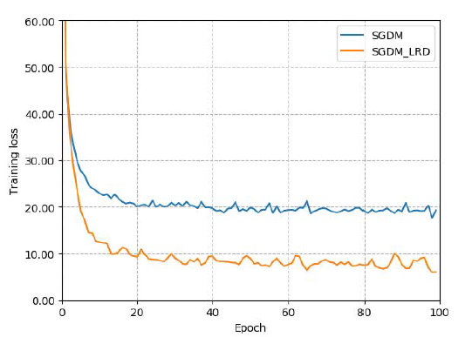
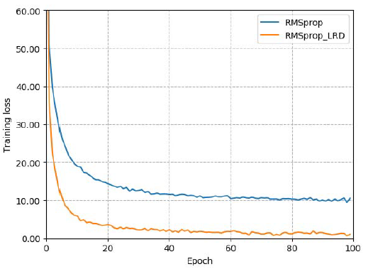
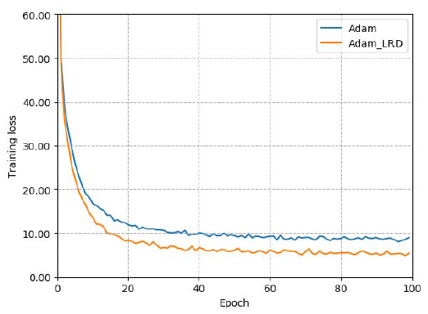
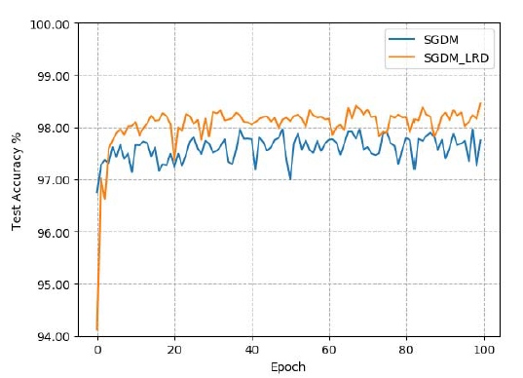
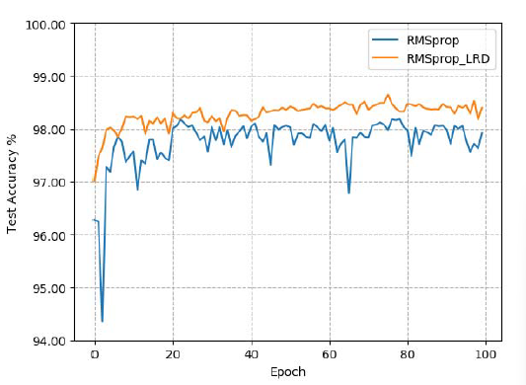
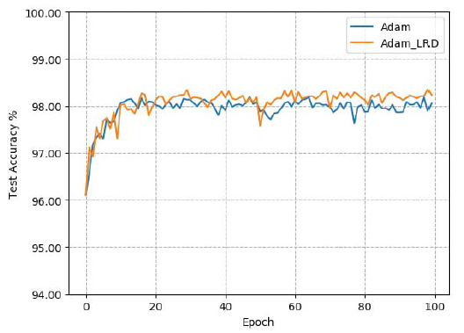
Image Classification – FC on MNIST
SGDM
RMSprop
Adam

Slide 23
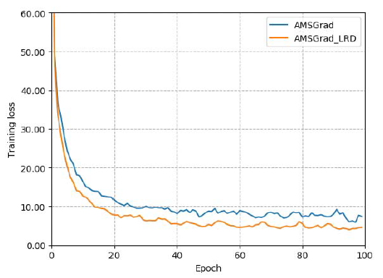
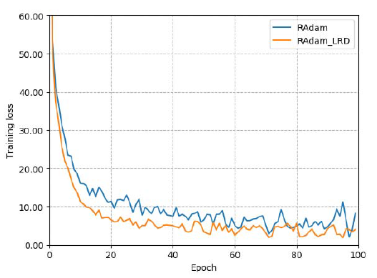
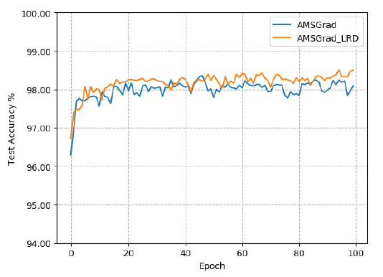
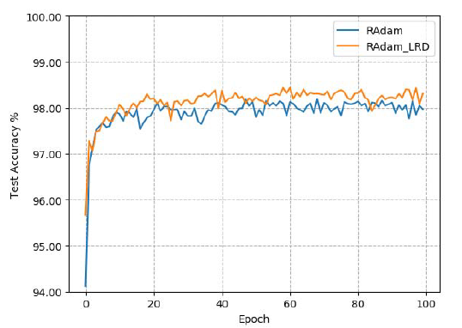
Image Classification – FC on MNIST
AMSGrad
RAdam

Slide 24
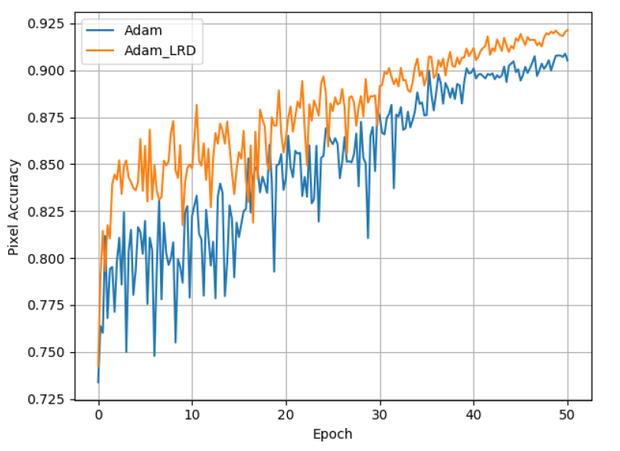
Image Segmentation – PSPNet on VOC2012

Slide 25
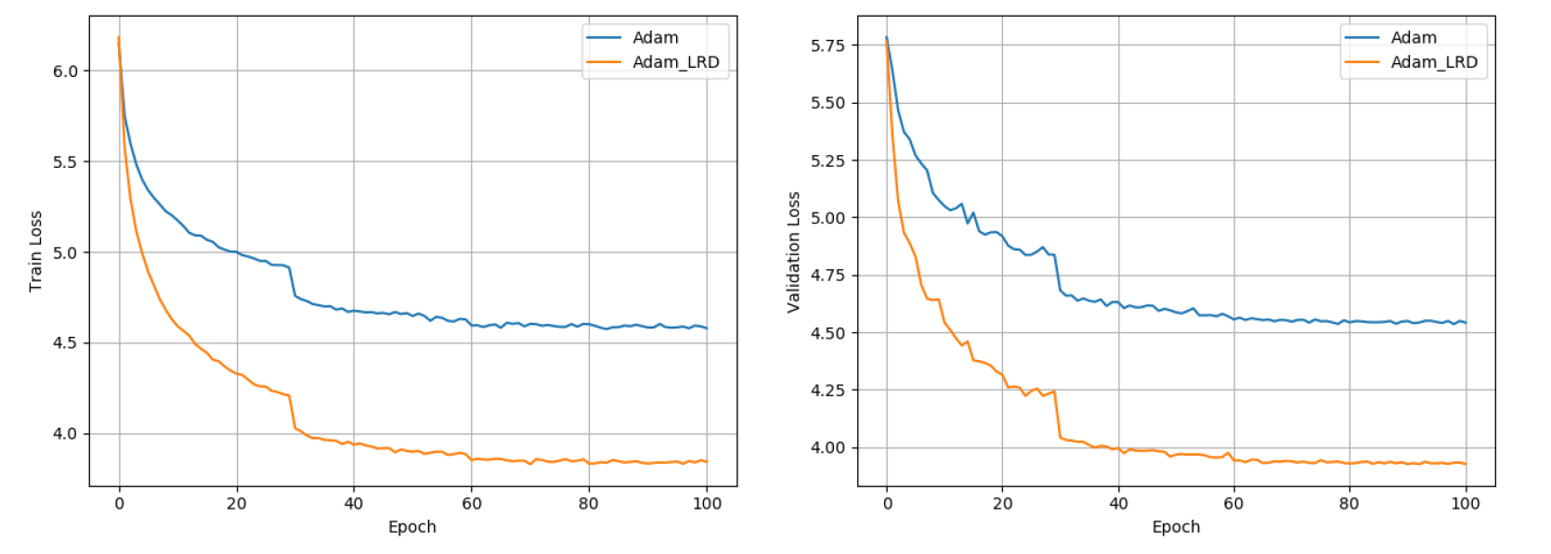
Object Detection – SSD on VOC2007

Slide 26
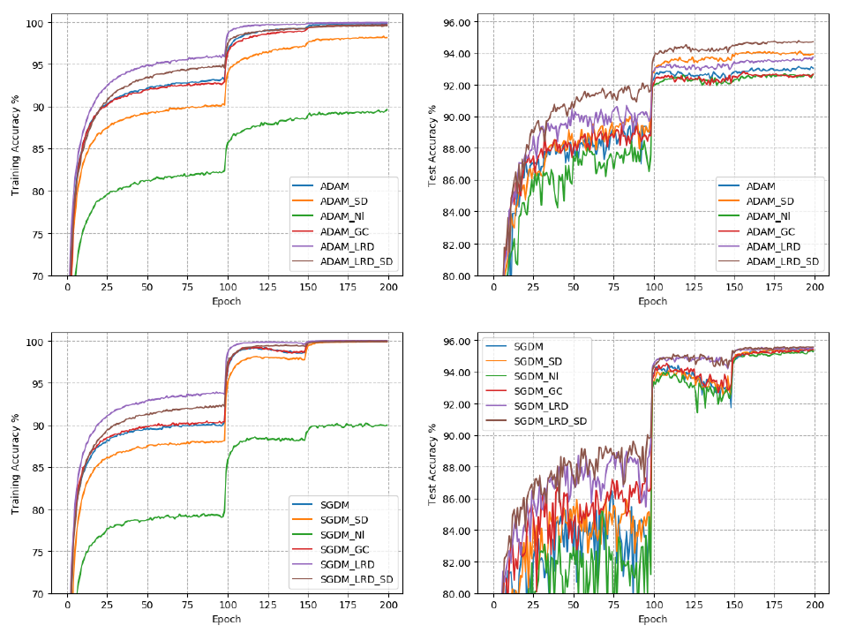
Compare With Other Regularizations
ResNet-34 on CIFAR10

Slide 27
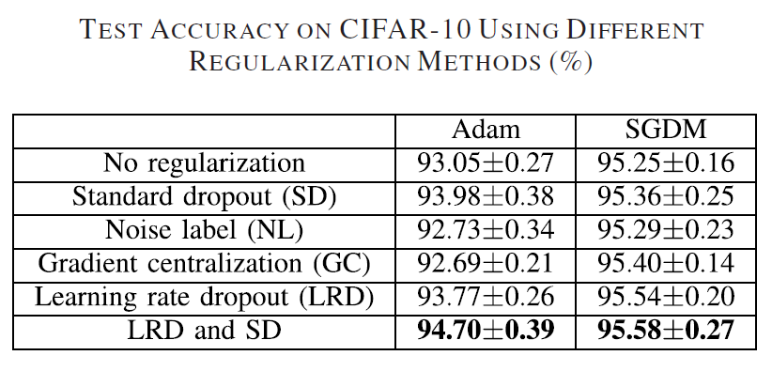
Compare With Other Regularizations
LRD can combine with other methods

Slide 28
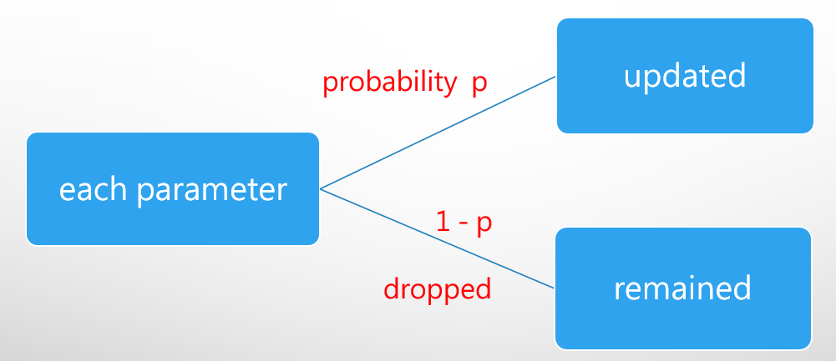
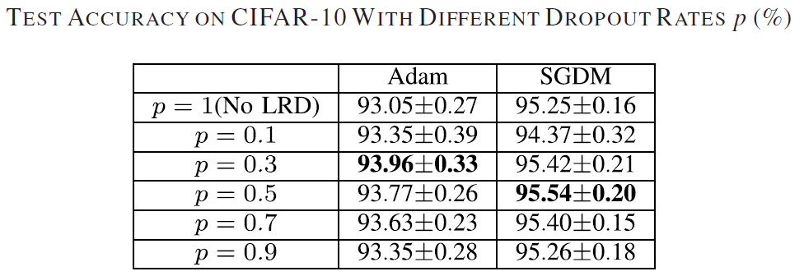
Ablation Study - Effect of Dropout Rate
Recall
Smaller p
Greater probability that the learning rate of each parameter will be drop
Faster convergence
Recommended p in range 0.3 to 0.7

Slide 29
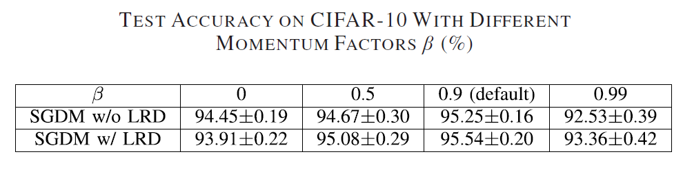

Ablation Study - Effect of Momentum Factor $β$
Recall
${ M}_{t}$ = $βM_{t−1} +$ $ηG_{t}$
$m_{t−1+λ}^{(i)}=β^{λ} m_{t−1}^{\left(i\right)}$ + $η$ $\left[ \sum_{ε=1}^{λ}{ β^{λ−ε} ∇f_{t−1+ε}(w_{t−1}^{(i)})} \right]$

Slide 30
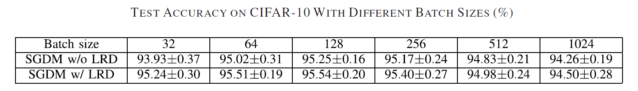
Ablation Study - Effect of Batch Size
Batch size too large poor generalization
( 一個一個看 vs 全部一起看 )
Smaller batch size
Larger gradients
Accumulating multiple gradients
Better generalization

Slide 31
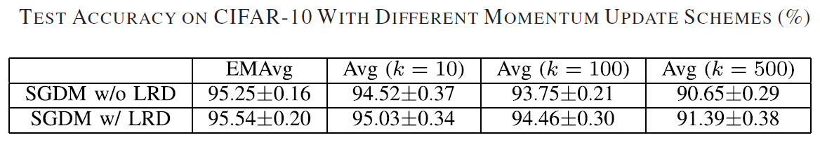
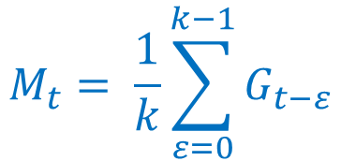
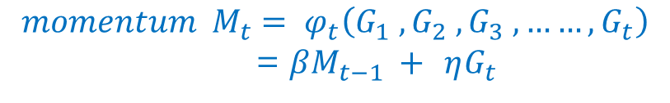
Ablation Study - Change Momentum
Recall
$$momentum { M}_{t}= φ_{t}\left(G_{1} , G_{2} , G_{3} , ……, G_{t}\right)$$
= $βM_{t−1} +$ $ηG_{t}$
Exponential Moving Average (EMA)
smaller
bigger
$$M_{t}= \frac{1}{k}\sum_{ε=0}^{k−1}{G_{t−ε}}$$

Slide 32
Conclusion

Slide 33
Accelerate training
Enhance generalization
Effective in a wide variety of application domains

Slide 34
Project proposal

Slide 35
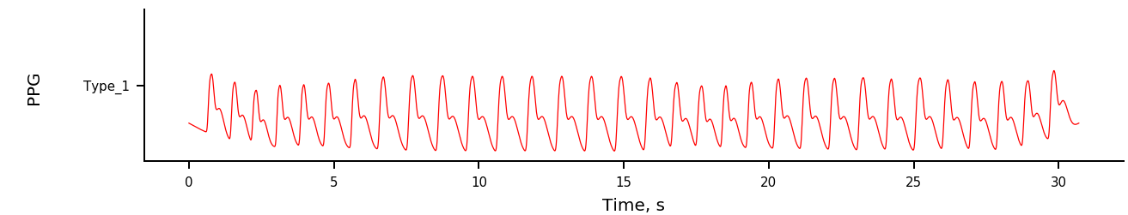
Detection of AF(atrial fibrillation) and APB(atrial premature beats) in PPG (photoplethysmography)
CNN+GRU
Architecture from Deep learning enables sleep staging from photoplethysmogram for patients with suspected sleep apnea https://doi.org/10.1093/sleep/zsaa098
Perform Mixup
Mixup: linear interpolations of input data
https://doi.org/10.48550/arXiv.1710.09412
Manifold Mixup: linear interpolations of hidden representations
https://doi.org/10.48550/arXiv.1806.05236
Regularization analysis
Data Set
SIM_ARR(PPG Signal Simulator with Arrhythmia Episodes)
https://physionet.org/content/ecg-ppg-simulator-arrhythmia/1.3.0/

